Slide 1
Mental Health Analysis Presentation

Slide 2
Project analysis slide 2
Mental Health Analysis
GENDER
MECHANISM
Suicide Rates
AGE
LATITUDE
GDP

Slide 3
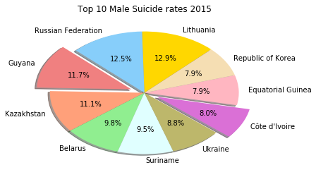
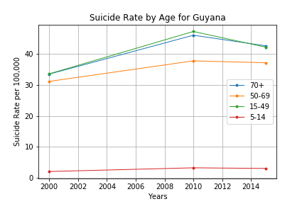
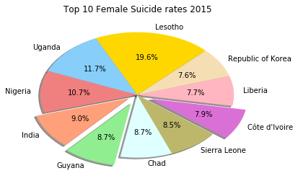
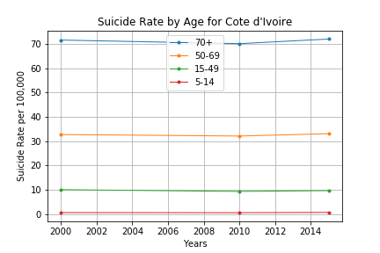
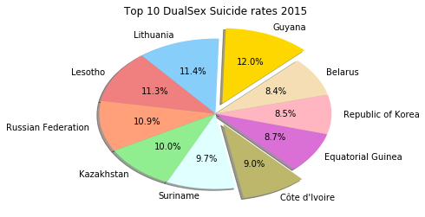
Project analysis slide 5
Suicide Rates Analysis
Year 2015
Guyana
11.7 % Males
8.7 % Females
12.0 % Both Sexes
Age Ranges: 15-49; 70+ years
Cote d’Ivoire
8.0 % Males
7.9 % Females
9.0 % Both Sexes
Age Ranges: 70+ years
Republic of Korea
7.9 % Males
7.6 % Females
8.5 % Both Sexes
Age Ranges: Data Unavailable
Note 1 : % number = pie size from among the top 10 countries with highest Suicide rate
Note 2 : Common countries from all genders analyzed by age groups.

Slide 4
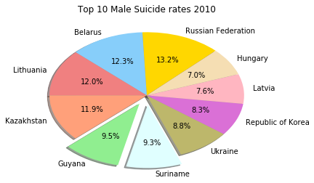
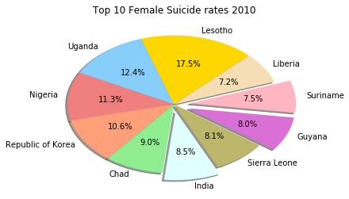
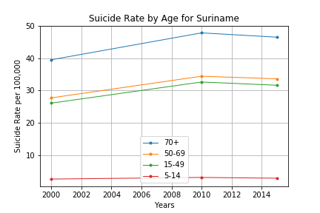
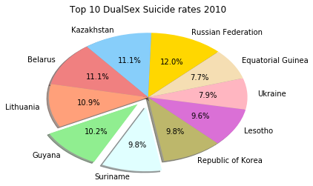
Project analysis slide 5
Suicide Rates Analysis
Year 2010
Guyana
9.5 % Males
8.0 % Females
10.2 % Both Sexes
Age Ranges: 15-49; 70+ years
Suriname
9.3 % Males
7.5 % Females
9.8 % Both Sexes
Age Ranges: 70+ years
Republic of Korea
8.3 % Males
10.6 % Females
9.8 % Both Sexes
Age Ranges: Data Unavailable
Note 1 : % number = pie size from among the top 10 countries with highest Suicide rate
Note 2 : Common countries from all genders analyzed by age groups.

Slide 5
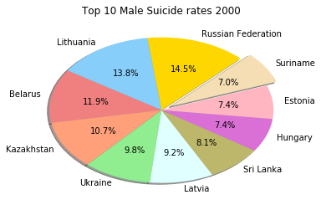
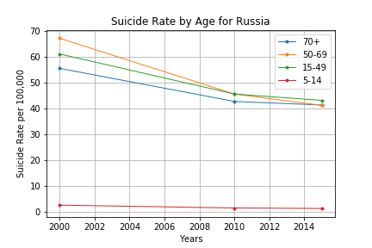
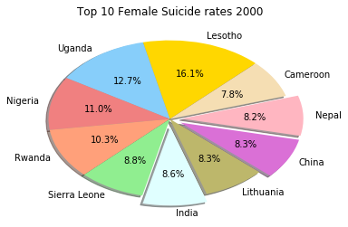
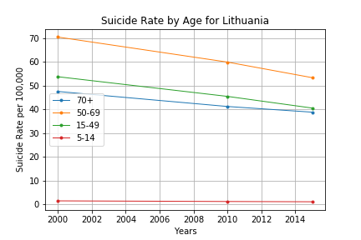
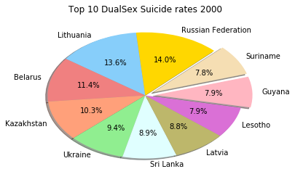
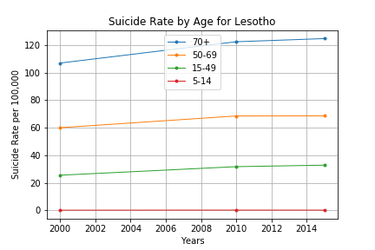
Project analysis slide 5
Suicide Rates Analysis
Year 2000
Russian Federation
14.5 % Males
?? % Females
14.0 % Both Sexes
Age Ranges: 50-69 years
Lithuania
13.8 % Males
?? % Females
13.6 % Both Sexes
Age Ranges: 50-69 years
Lesotho
?? % Males
16.1 % Females
7.9 % Both Sexes
Age Ranges: 70+ years
Note 1 : % number = pie size from among the top 10 countries with highest Suicide rate
Note 2 : Common countries from all genders analyzed by age groups.

Slide 6
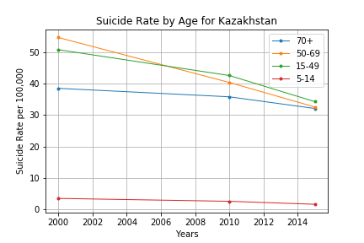
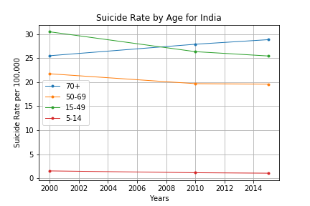
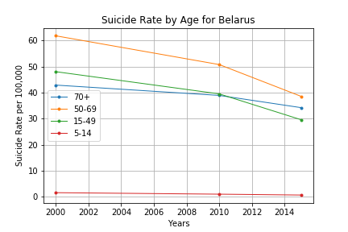
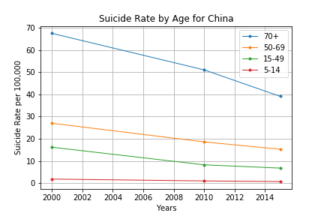
Project analysis slide 5
Suicide Rates Analysis
Years: 2000 - 2015
Kazakhstan, Belarus
Listed among the top 10 countries with Suicide rate estimates in male and both sex gender categories.
India, Lesotho, Uganda, Nigeria, Sierra Leone
Listed among the top 10 countries with Suicide rate estimates in female gender categories.
China
Listed among the top 10 countries with Suicide rate estimates in female gender categories.in year 2000 only.

Slide 7
Thank You

Slide 8
Backup
Suicide Rate Analysis per each year
Years 2015, 2010 and 2000
Within each year analysis split per each gender category
Gender categories: Male, Female & Both Sexes
The Pie Chart shows the top 10 countries sorted with highest suicide rates for each gender category
Identified 3 countries that are common in all the 3 pie charts.
% number = Size of pie slice
Pulled out the Age group data separately for 3 common countries
Line graphs on the right side of the slides shows 4 lines in age groups (5-14, 15-49, 50-69, and 70+).
X axis represents the Time period 2000, 2010 & 2015
Y axis represent the Suicide rate per 100,000

Slide 9
Countries and Region
Cote d'Ivoire is a country in West Africa
Guyana is a country in South America
Suriname is a country in South America next to Guyana
Republic of Korea aka South Korea
Lesotho is a country in Africa Landlocked country by South Africa
Uganda is a country in East Africa
Nigeria is a country in West Africa
Sierra Leone is a country in West Africa
Belarus is a neighboring country to Lithuania in Europe
Lithuania is a neighboring country to Belarus in Europe

Slide 10
Backup

